Slide 1
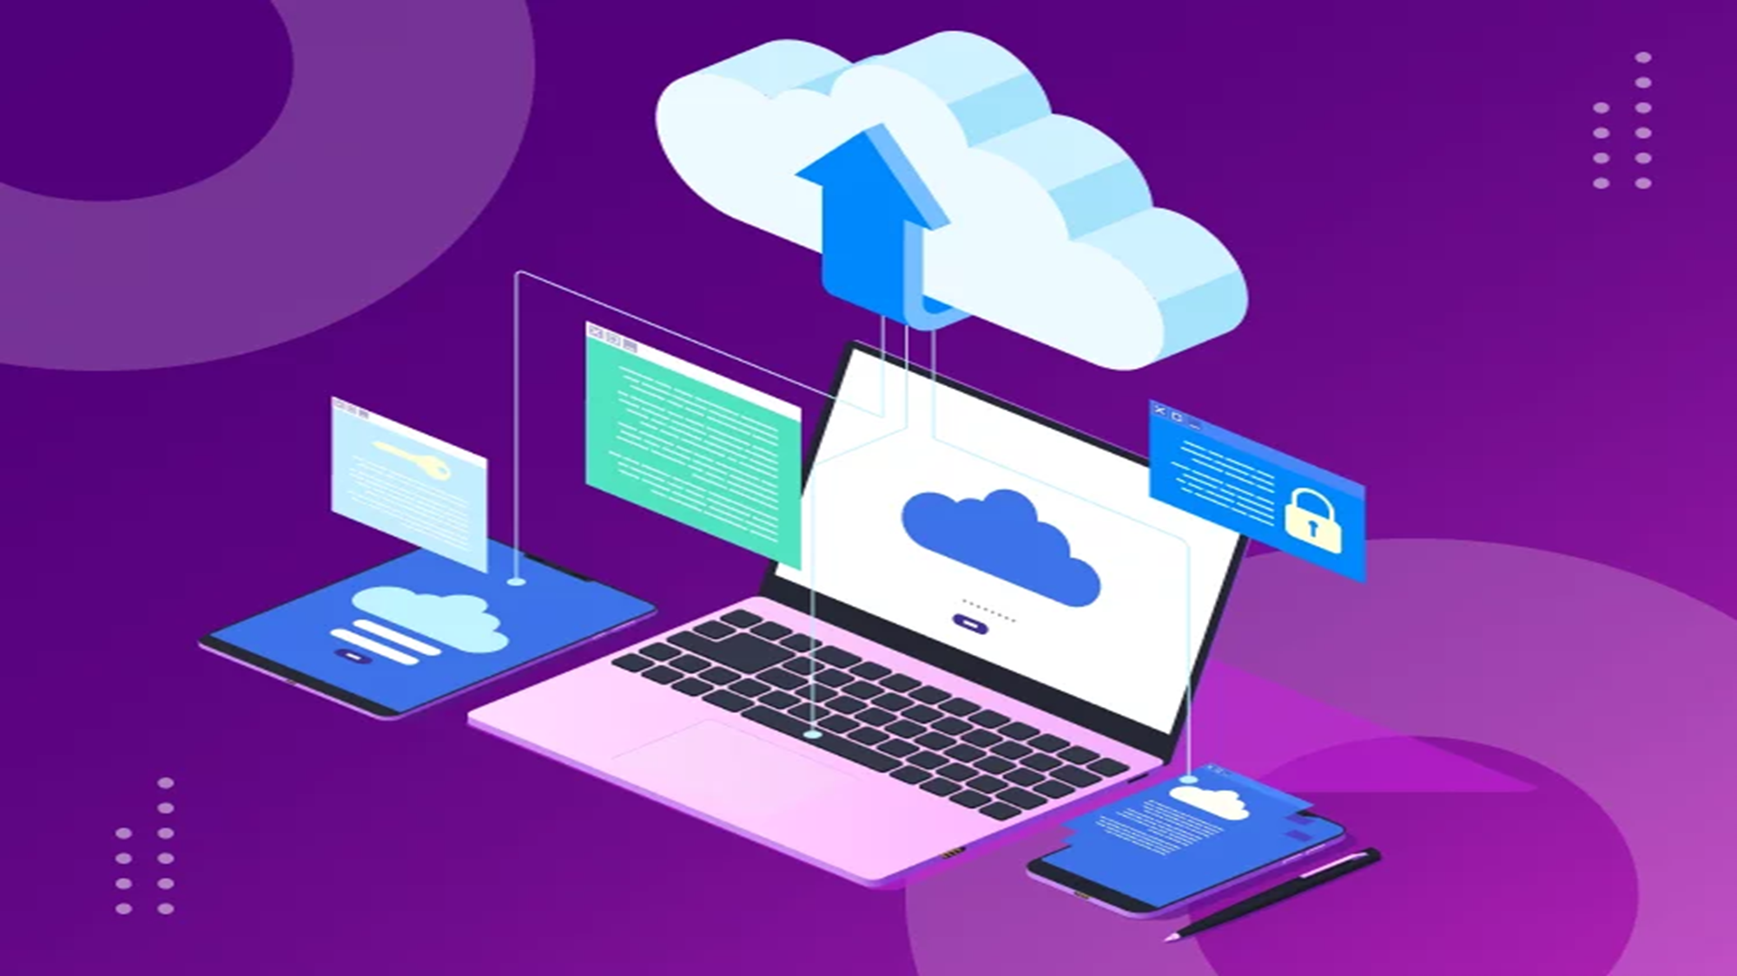

SeCURE STORAGE USING HYBRID CRPTOGRAPHY
Project Guide:
Prof. Selvam sir

Slide 2

TEAM MEMBERS
By Group 2:-
SHRUTI KAMBALI (AI 29)
POORVA PADVE (AI 43)
GHANSHYAM GADEKAR (AI 18)
POORVA PATIL (AI 46)

Slide 3

PROJECT PRE-REQUISTES
Hardware Requirements:
Computer/laptop
Intel i3 6th Gen or higher/4gb Ram
Software Requirements:
Python
Flask
HTML
CSS
JavaScript

Slide 4

INTRODUCTION
Accessing data from any location.
The stored type of file is completely secured.
This prevents data leak if a breach occurred.

Slide 5

PROPOSED SYSTEM
A secure file and password storage using cryptography.
A proper registration/login based system for using the website.
The system will help user to secure data using different encryption algorithm .
User can upload passwords as well as text files.
The user with the proper key will be able to access the particular file.
The primary goal of the system is to provide and simulate an solution to face the challenges and solve security issues that exists in cloud computing.

Slide 6
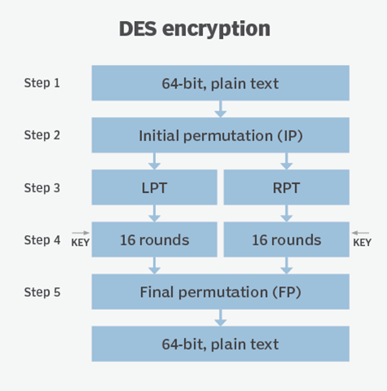
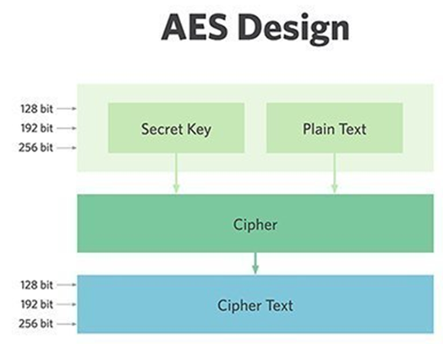
Algorithm
DES :
Data Encryption Standard (DES) is a symmetric-key block cipher.
Encrypts data in blocks of size of 64 bits each and Key length is 56 bits.
DES is based on the two attributes: substitution and transposition.
DES consists of 16 rounds. The result of this process produces 64-bit cipher text.
AES :
Advanced Encryption Standard (AES) is based on ‘substitution–permutation network’.
The key size can be 128/192/256 bits.
The number of rounds depends on the key length: 10/12/14 rounds.
Encrypts data in blocks of 128 bits each.

Slide 7
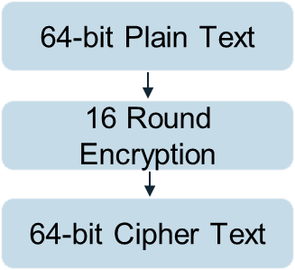
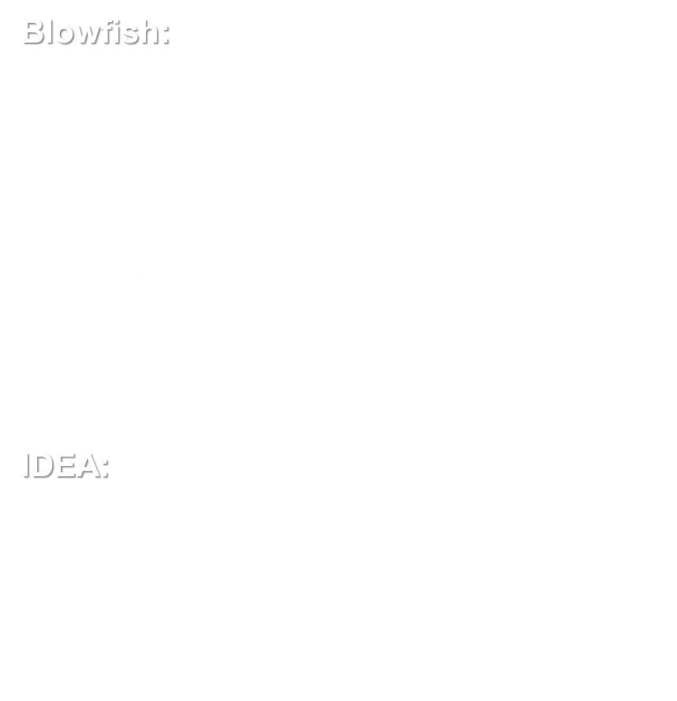
Investment goals
Blowfish Design
IDEA Design

Slide 8

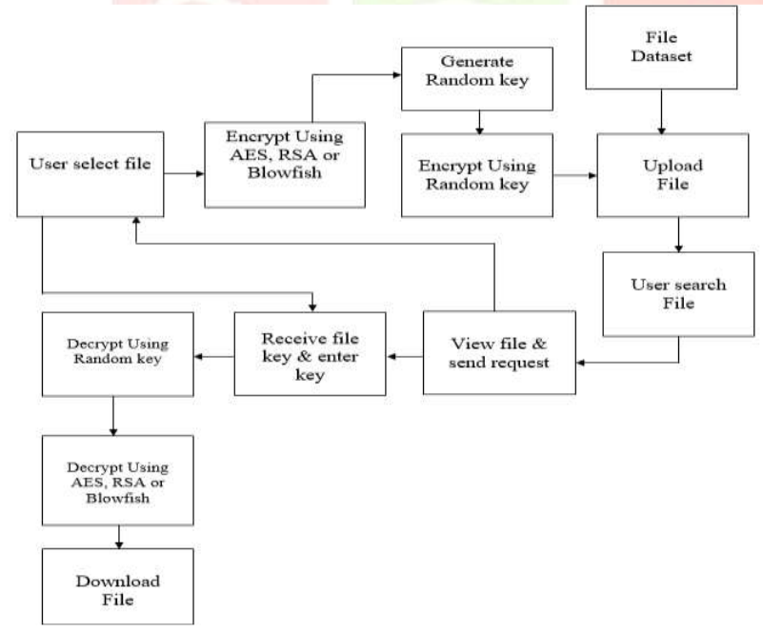
PROJECT OVERFLOW

Slide 9

SCOPE
In the world of data being the key asset, safeguarding our asset is primary responsibility. Communications, databases, infrastructure, transactions, knowledge; an organization’s data is arguably its most valuable asset. It is in a business’ best interests to keep its information safe, regardless of legal or regulatory requirements.
A system which stores data after encryption.
This prevents data leak if a breach occurred.
Any form of data can be stored.
It ensures data confidentiality to users.

Slide 10

Conclusion
The main aim of this system is to securely store and retrieve data that is only controlled by the owner of the data.
storage issues of data security are solved using cryptography and steganography techniques.
In the future we can add public key cryptography to avoid any attacks during the transmission of the data from the client to the server.
This project implements a double stage encryption algorithm that provides high security, scalability, confidentiality and the easy accessibility of multimedia content .
The proposed algorithm is crucial in the second stage, the randomly generated key provides more security than the conventional encryption system.
The ciphertext is stored in the cloud instead of original multimedia content. The cipher text is undoubtedly hard to recover the original content for random asymmetric key.
Wide application of the proposed algorithm protects the information from the side channel attacker to grab the multimedia data .

Slide 11

THANK YOU!

